Slide 1

AI Virtual Mouse and Keyboard
Instrumentation and Control engineering [2019-2023]
Group-29

Slide 2


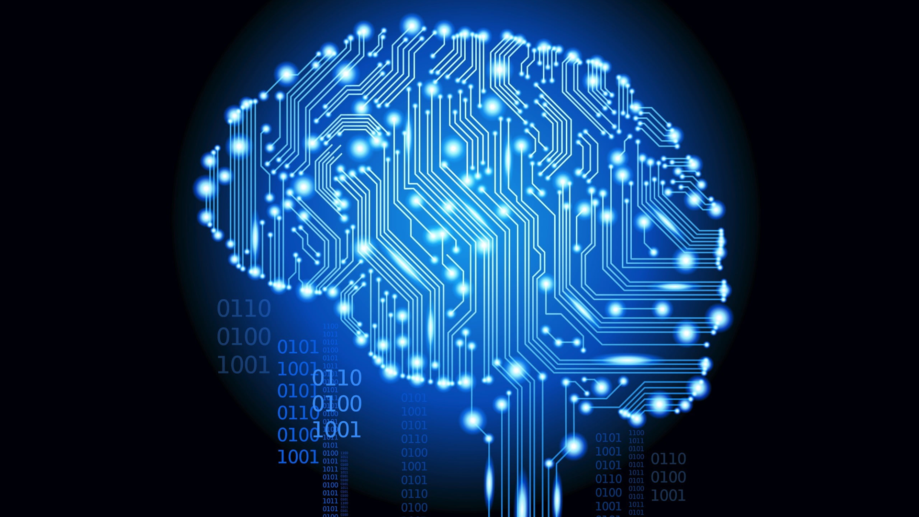
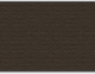
Contents:
Introduction
Virtual Mouse and Keyboard
Problem description and Objective
Components Required
Software
Implementation
Block- Diagram
Code
Applications
References

Slide 3
Abstract
We know that Mouse and Keyboard is one of the amazing inventions of Human-Computer Interaction (HCI) technology. Currently, wireless mouse or a Bluetooth mouse/keyboard uses some other dependent devices and is not completely free as it uses a battery for power and a dongle to connect it to the Laptop.
In our, AI virtual mouse system, this limitation can be overcome by using webcam or a built-in camera for capturing of hand tips and hand gestures detection using computer vision. The algorithm used in the system makes use of the machine learning algorithm. Based on the hand gestures, the computer can be controlled virtually and can perform left click, right click, scrolling functions, and computer cursor function without the use of the physical mouse and keyboard.

Slide 4
Introduction:
In this new Era, Technology is taking up a new phase so we need to use it for the enhancement of society. Computer Vision is an artificial intelligence, it enables systems to derive substantial information from digital images, videos, and other visual inputs that can be used to work on and make recommendations.
This system detects the user's hand and tracks its movement to navigate the perform mouse and keyboard functions in place of those physical devices.

Slide 5

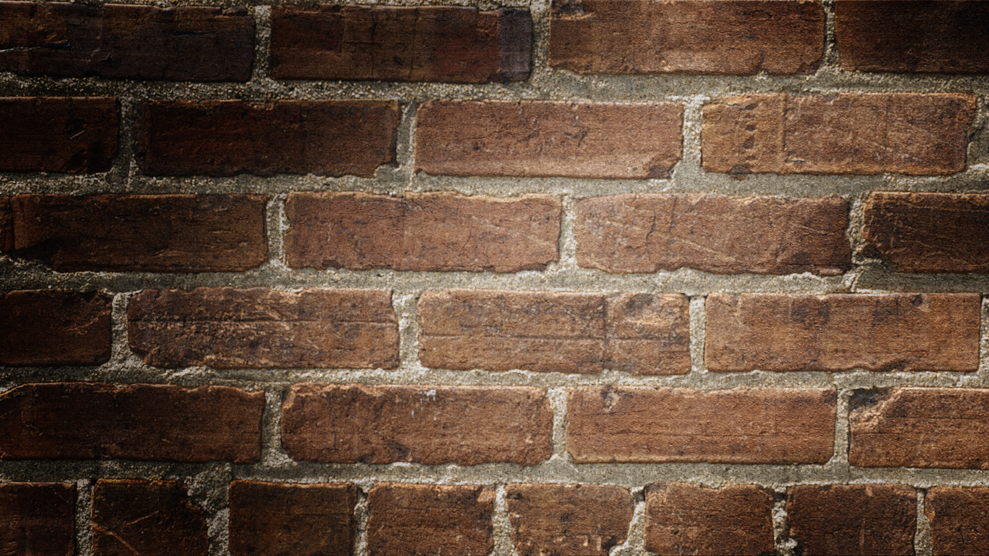
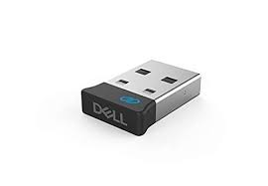
While using a wireless or a Bluetooth mouse or keyboard , these devices use the dongle to connect to the PC, and also, a battery to power up the mouse to operate, but here we use built-in camera or a webcam and uses their hand gestures to control the computer mouse and keyboard operations.
In the proposed system, the web camera captures and then processes the frames that have been captured and then recognizes the various hand gestures and hand tip gestures and then performs the particular functions instead of using a traditional mouse device.

Slide 6
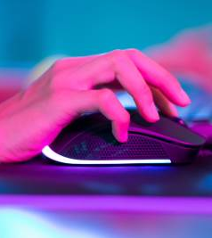
. Objective
The main objective of the AI virtual system is to develop an alternative to the traditional mouse system to perform and control the mouse and keyboard functions, and this can be achieved with the help of a web camera that captures the hand gestures and hand tip and then processes these frames to perform the particular function such as left click, right click, scrolling function and key selections of keyboard.

Slide 7

Hardware & Software Components:
Camera / Web cam
Interfacing software-Python
IDE – Pycharm
OpenCV
Dependencies- Numpy , Autopy, MediaPipe

Slide 8

Python
Here we used Python programming language for developing the AI virtual keyboard and mouse system.
Python offers a vast choice of libraries for AI development, which contain base-level items that save coding time. These libraries also make it easy to access, handle, and transform and it doesn’t need compiling into machine language instruction to be executed.
It also offers amazing visualization tools which is of great use in AI as it involves the representation of data in a human-readable format.

Slide 9
MediaPipe and opencv
MediaPipe is a cross-platform library developed by Google that provides amazing ready-to-use ML solutions for computer vision tasks like face detection, multi-hand tracking, object detection, and tracking etc.
OpenCV is a library of python programming language, where real-time computer vision applications can be developed by using the computer vision library. It is widely used for image analysis, image processing, detection, recognition, etc.

Slide 10
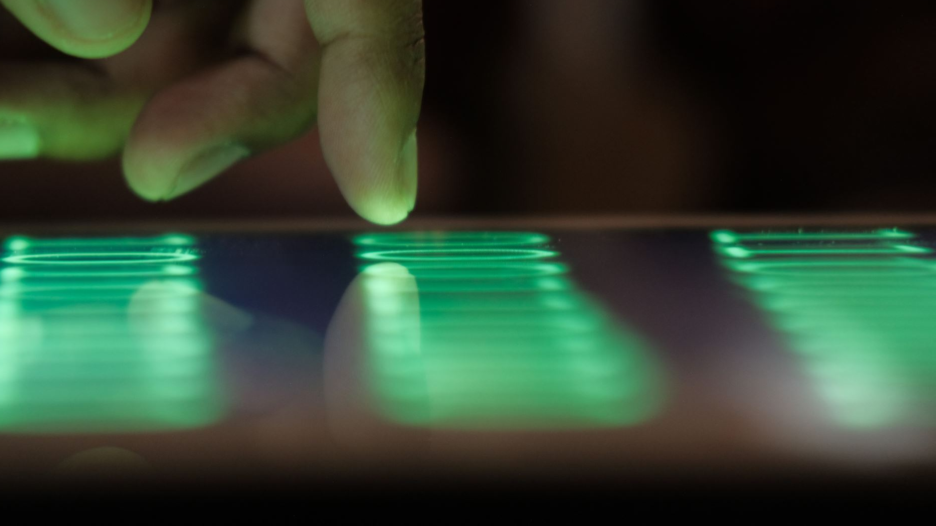
Algorithm Used for Hand Tracking
For the purpose of detection of hand gestures and hand tracking, the Media Pipe framework is used, and OpenCV library is used for computer vision .The algorithm makes use of the machine learning concepts to track and recognize the hand gestures and hand tip.

Slide 11
Single-shot detector model
Single-shot detector model is used for detecting and recognizing a hand or palm in real time.
The single-shot detector model is used by the MediaPipe.
For the hand detection it is trained for a palm detection model.
Furthermore, this model works significantly better on small objects such as palms or fists .
A model of hand landmark consists of locating 21 joint or knuckle co-ordinates in the hand region, is shown.

Slide 12
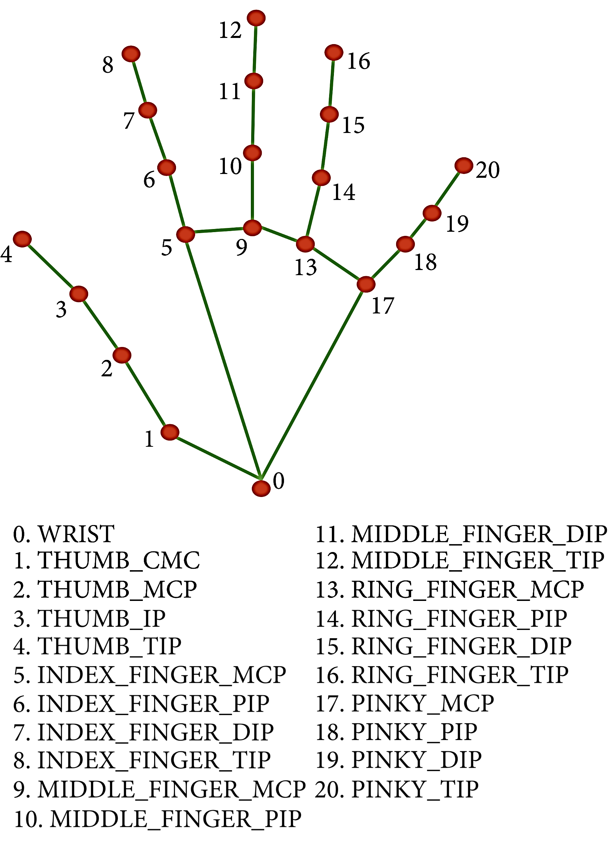

Slide 13
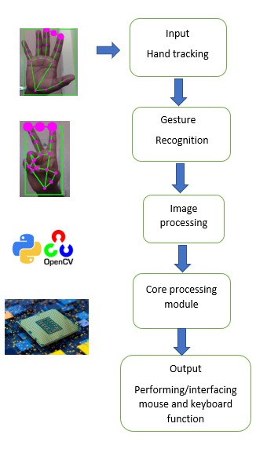
Block Diagram

Slide 14

Implementation
The various functions and conditions used in the system are explained in the flowchart of the AI virtual system .

Slide 15
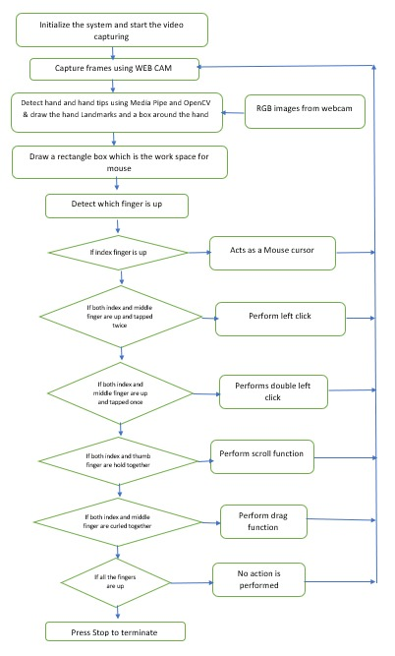

Slide 16
The Camera Used in the AI Virtual System
The AI virtual system is based on the frames that have been captured by the webcam in a laptop .
With the help of Python OpenCV, the video capture object is created and the camera will start capturing the video.
The Camera captures and passes the frames to the AI virtual system.

Slide 17
Capturing the Video and Processing
The AI virtual system uses the camera where each frame is captured till the termination of the program.
Then the video frames are processed from BGR to RGB colour space to find the hands in the video frame by frame .

Slide 18
(Virtual Screen Matching) Rectangular Region for Moving through the Window
The AI virtual mouse system makes use of the transformational algorithm, and it converts the co-ordinates of fingertip from the webcam screen to the computer window full screen for controlling the mouse. When the hands are detected and when we find which finger is up for performing the specific mouse function, a rectangular box is drawn with respect to the computer window in the webcam region where we move throughout the window using the mouse cursor, .

Slide 19
Detecting Which Finger Is Up and Performing the Particular Function
Here we are detecting which finger is ‘up’ using the tip number of the respective finger using the MediaPipe and the respective co-ordinates of the fingers that are up and according to that, the particular mouse function is performed.

Slide 20
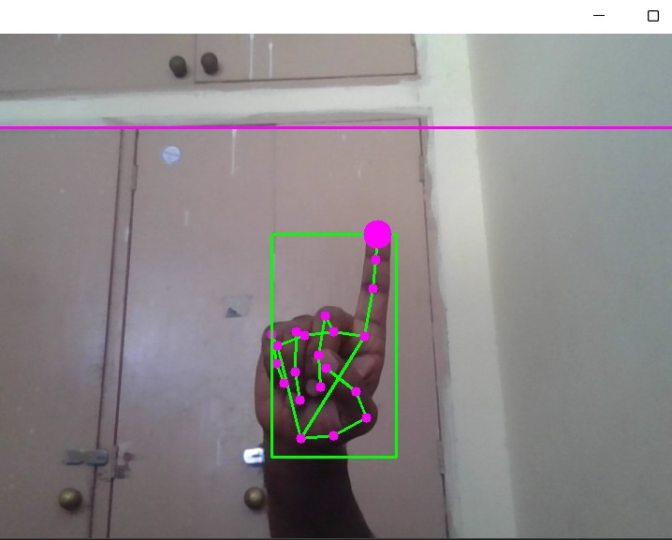
To move the cursor
If the index finger is up with tip number 1, the mouse cursor is made to move around the window of the computer using the AutoPy package of Python.

Slide 21
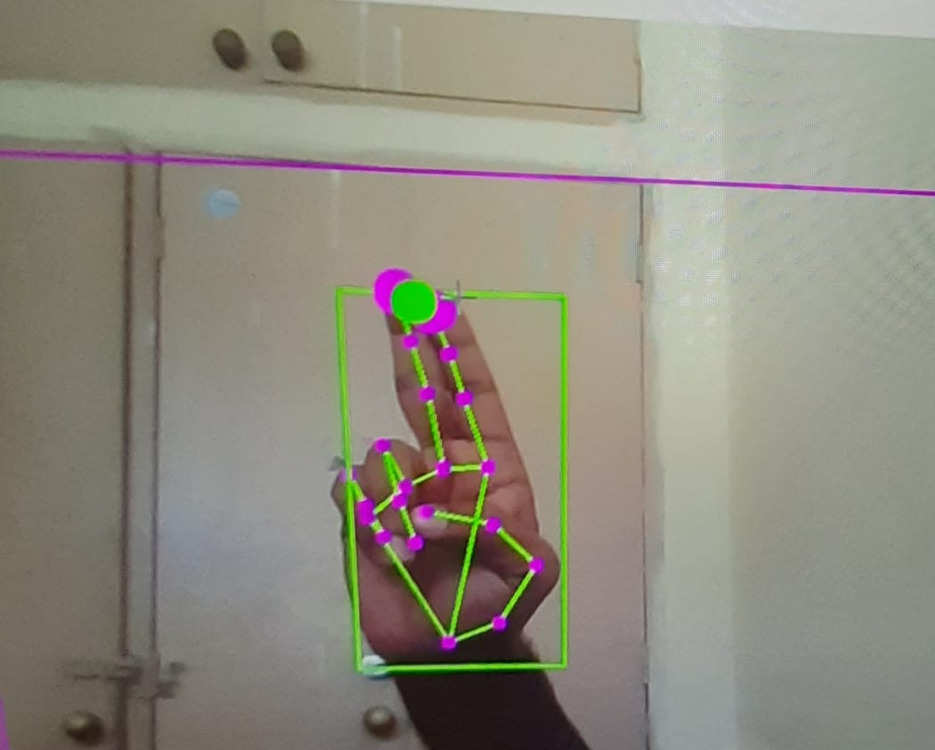
to Perform Left Click
In order to perform Left click, both the index finger and middle finger should be up and if we tap both the fingers twice then the system will perform Left click function.

Slide 22
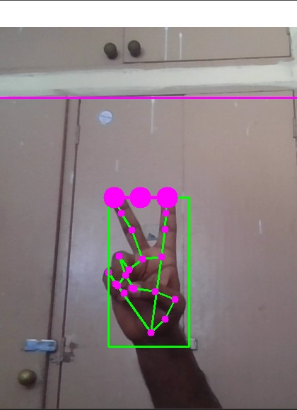
to Perform Double Click
In order to perform Double click , both the index finger and middle finger should be up and if we tap both the fingers once then the system will recognize it as Left click function.

Slide 23
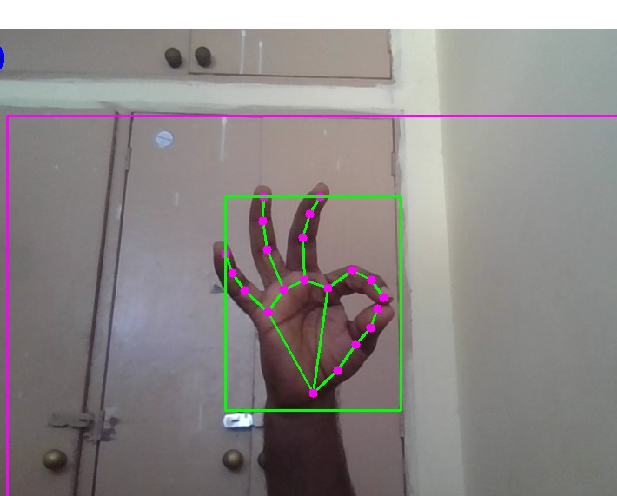
To Perform Scroll Function
If we hold both the index finger an the thumb finger then the system will perform scroll function according to the movement of the hand.

Slide 24
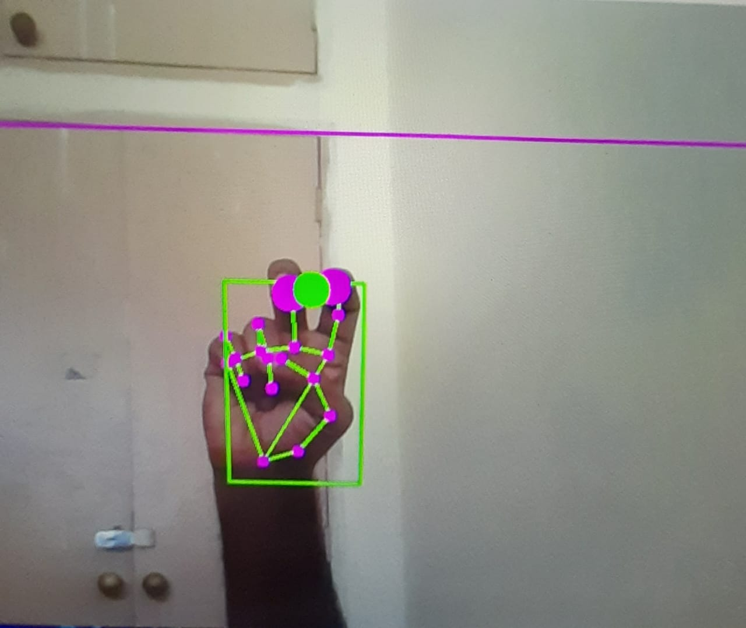
To perform drag function
To perform drag function the index and middle finger should be up and curl together then the system will perform drag function.

Slide 25
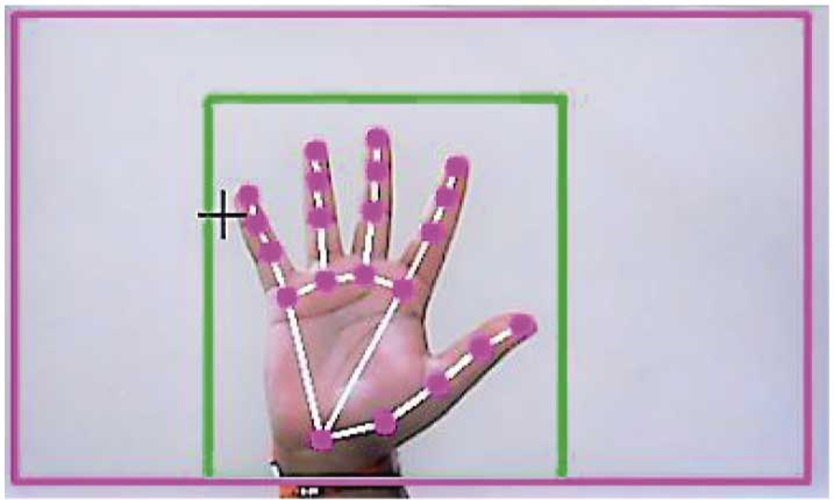
For No Action
If all the fingers are up , then the computer is made not to perform any mouse events in the screen.

Slide 26
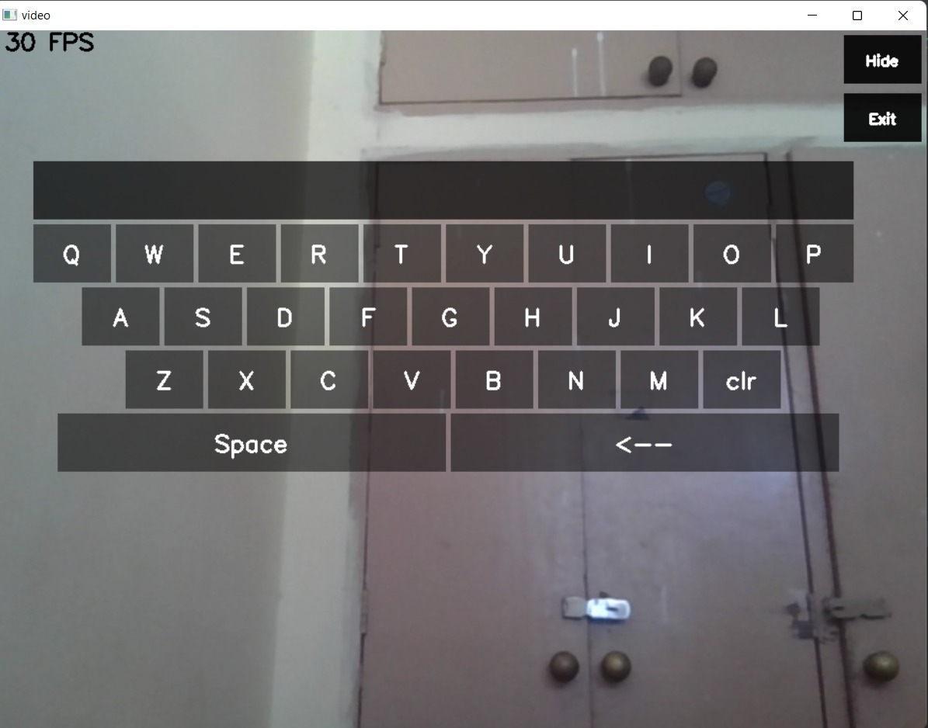
AI keyboard
With the help of python a Virtual keyboard interferace is created when we use the hand tracking module in order to perform different keyboard functions.
To select a key of keyboard we need to tap the index finger and thumb finger.

Slide 27
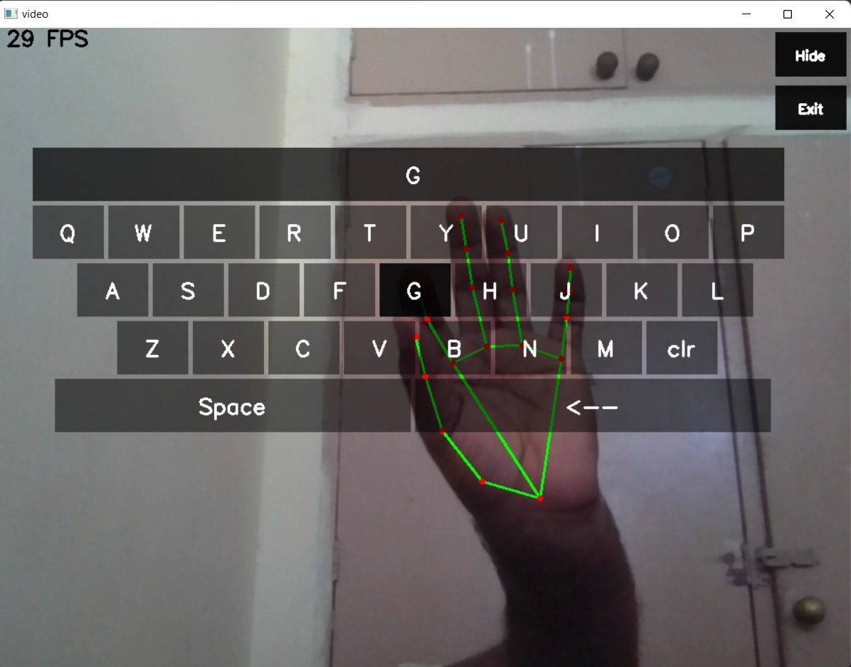

Slide 28
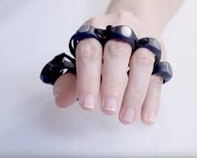
Project Scope:
Most physical keyboard & Mouses are not the most comfortable and Convenient.
This is a real time application and User friendly .
The project removes the requirement of having physical mouse and Keyboard.

Slide 29
Applications:
The AI virtual mouse and keyboard can be used in situations where we cannot use the physical mouse , this system eliminates the use of devices and improves human-computer interaction.
There is less exposure to physical damage.
We can design and interact with 2-Dimensional and 3-Dimensional images using the AI virtual system using the hand gestures.
It can also be used to play virtual reality- and augmented reality- based games without the wireless or wired mouse, keyboard or other input devices.
Easy to adapt.

Slide 30

References
1. Virtual Mouse
https://www.hindawi.com/journals/jhe/2021/8133076/
2.Computer Vision
https://www.computervision.zone

Slide 31
CODE
https://github.com/Unique57/AI_Mouse-Keyboard.git

Slide 32
Guided by: Dr. Sathiya S
Submitted by:
P D V Pavan -19106060
Harsha Vardhan Nakka-19106032
Akula Rahul Ranga Venkat- 19106007
Dasarath-19106023

Slide 33
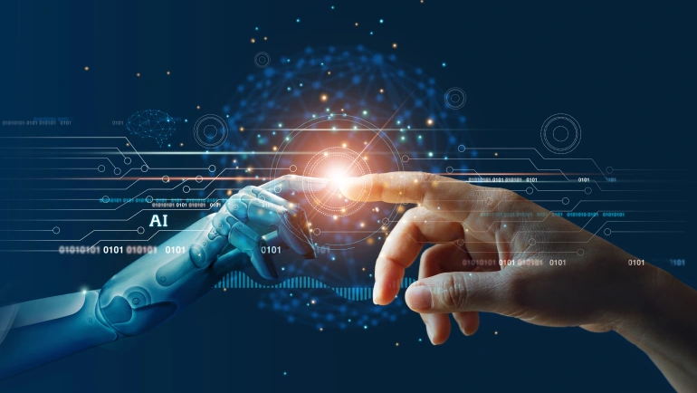
Thank you

